Slide 1
Winterlude Concept design
Komal devi

Slide 2
INFORMATION ARCHITECTURE

Slide 3

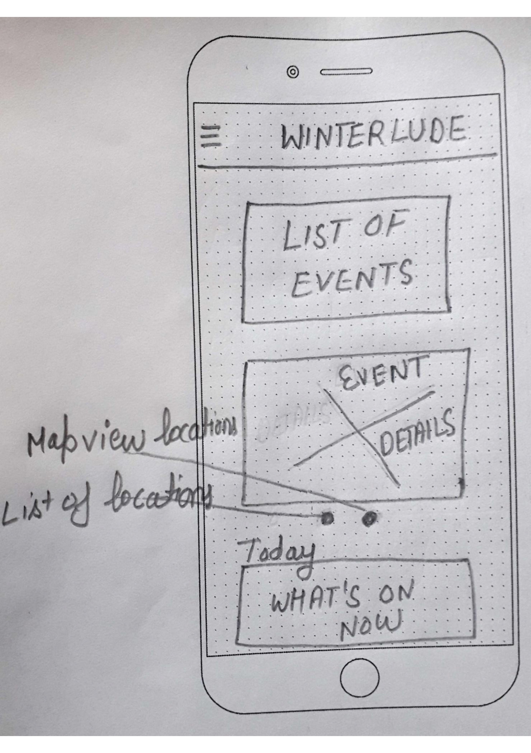
HOME/LANDING SCREEN Contains: . LIST OF EVENTS . EVENTS DETAILS .TODAY’S WHAT’S ON NOW

Slide 4
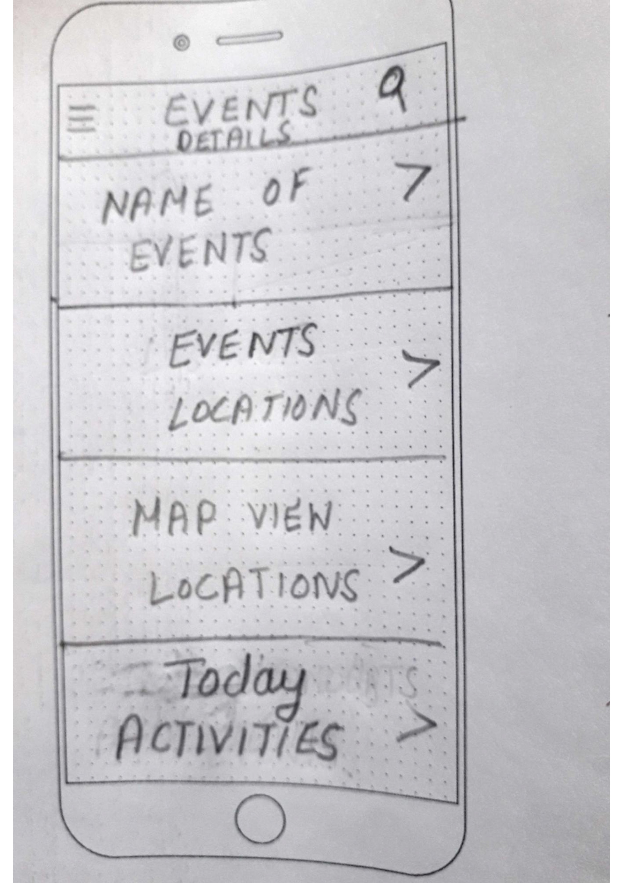
SECTION SCREEN(EVENTS DETAILS) .Events page .Events locations . Map Locations. .Showing today activities.

Slide 5
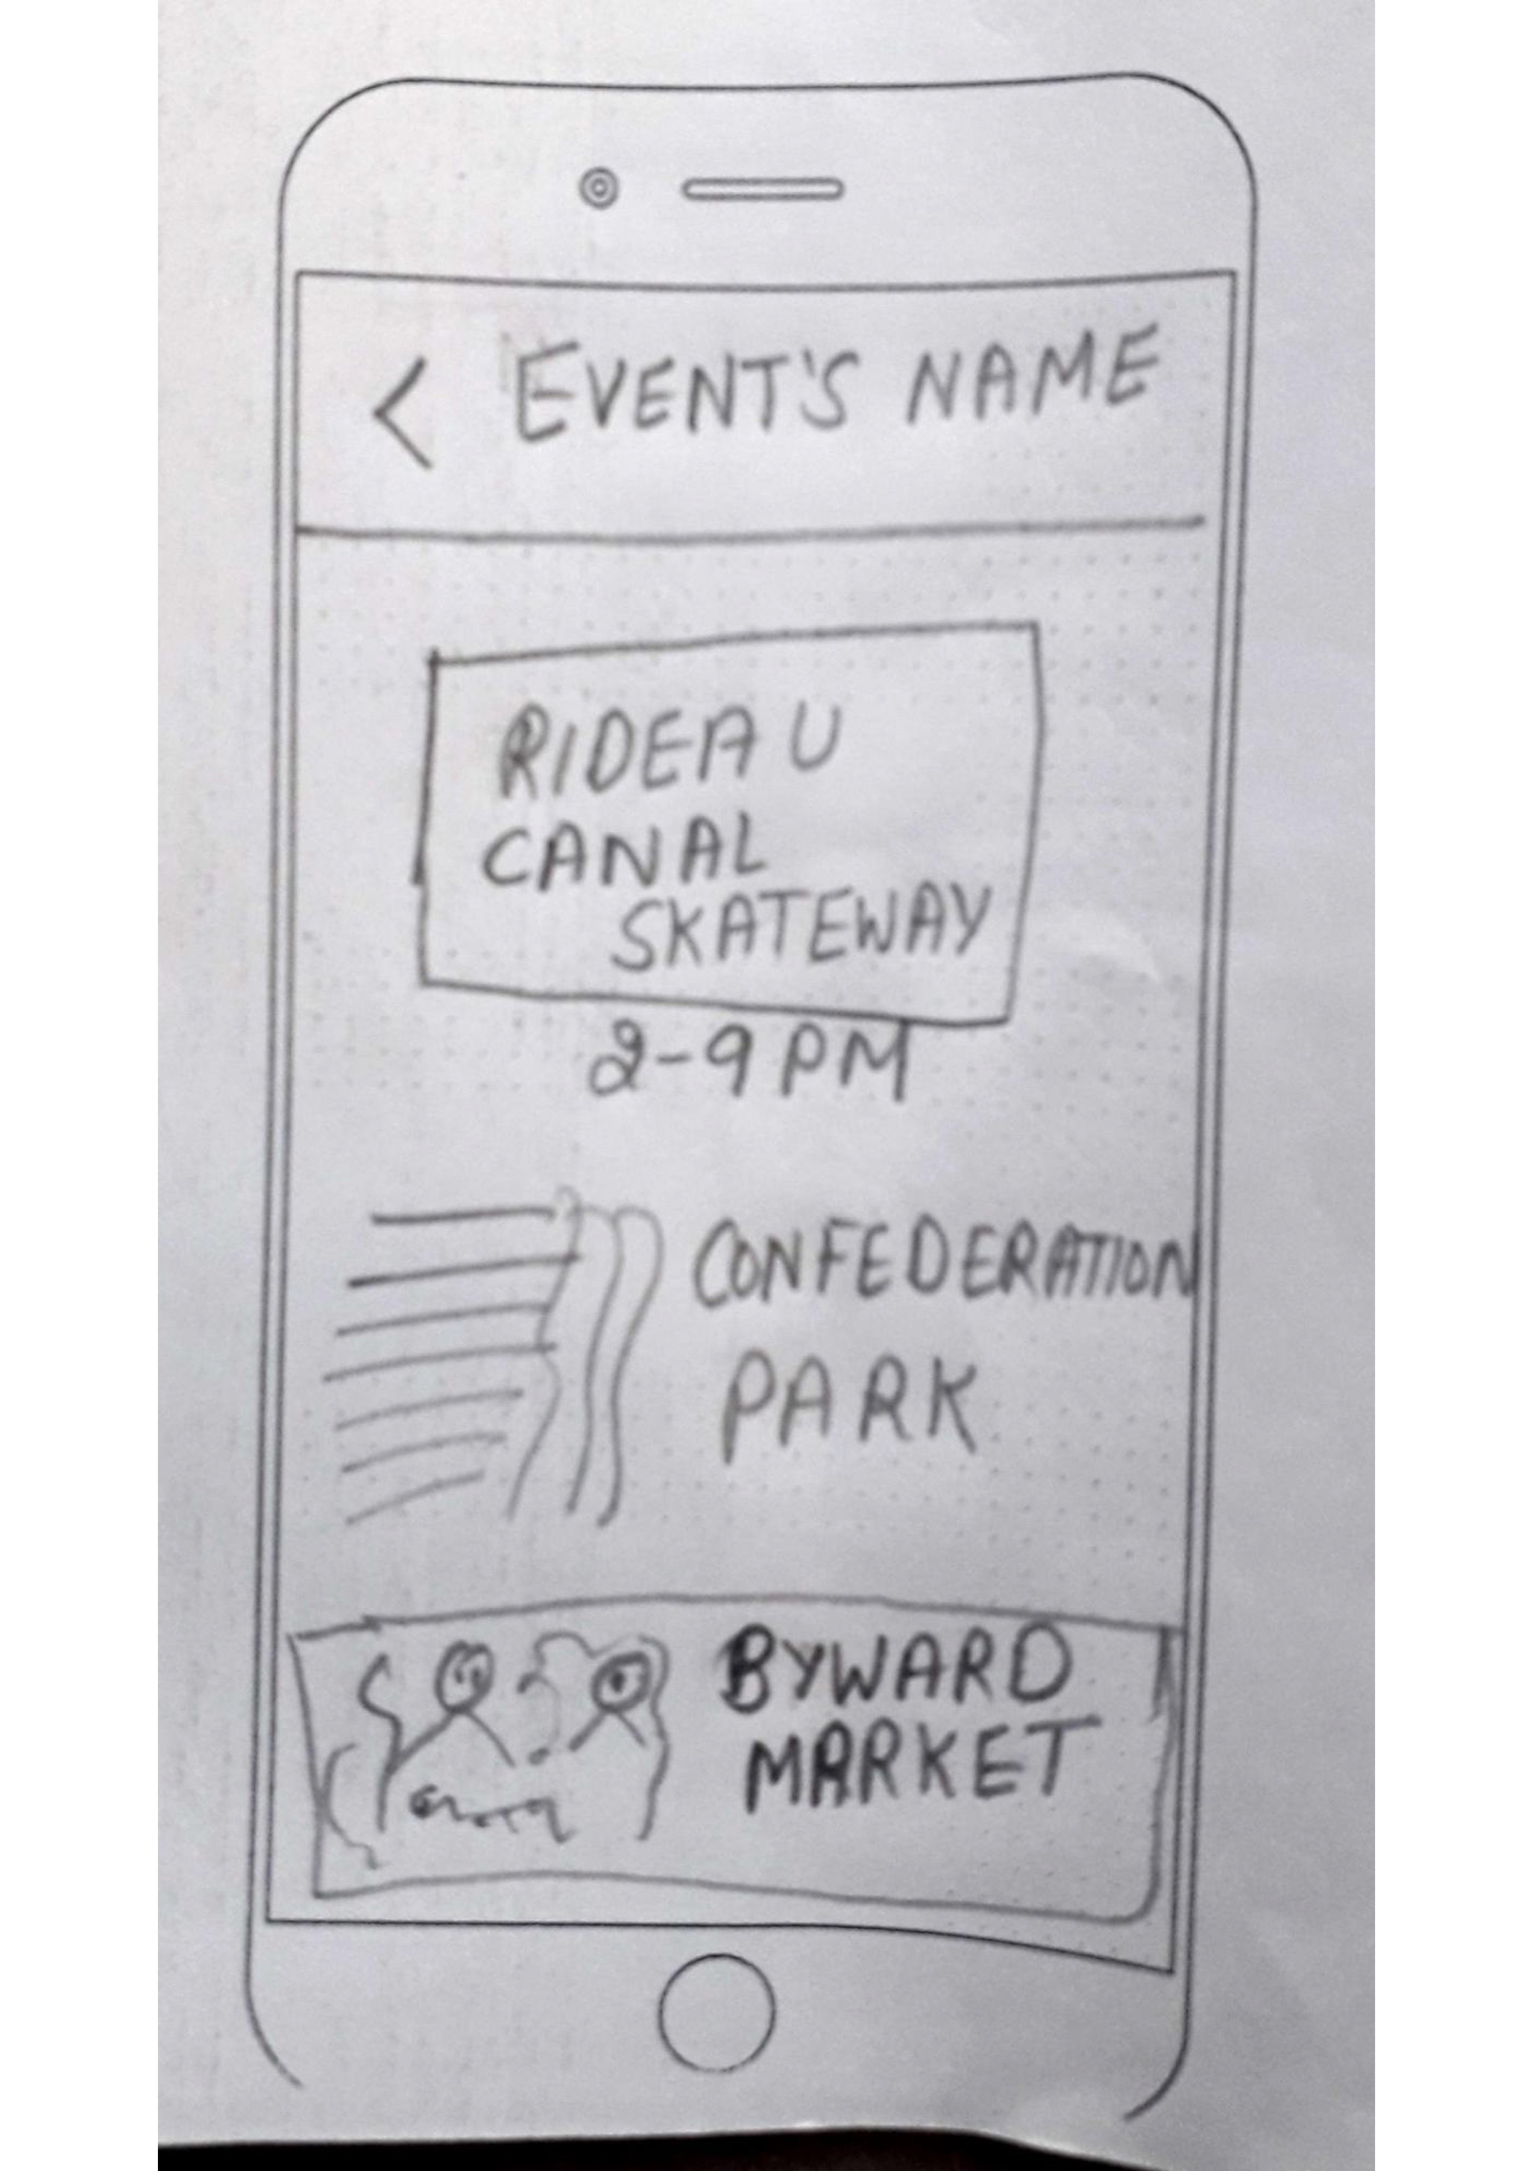
SUBSCREEN (EVENTSNAME) Main image,text, back button.

Slide 6
CONCEPT DESIGN

Slide 7

QUESTIONS?

